Slide 1
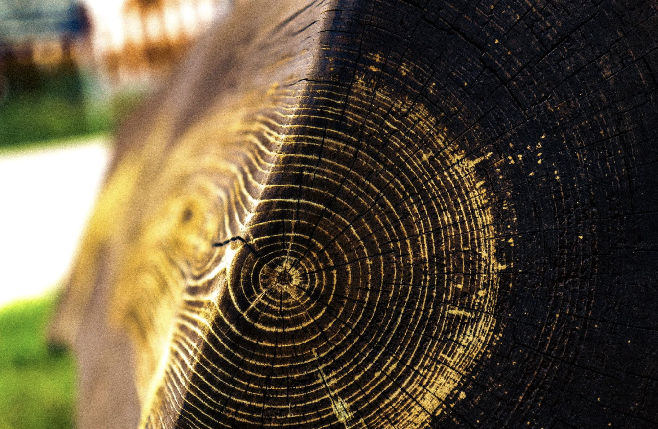
Photography Portfolio
Adiena Jarbo

Slide 2
All about Adiena Jarbo
My name is Adiena, I have lived in Rye my entire life. My friends and sister are my whole world. I really enjoy being in FFA and my ag class. Another of my passions is Photography. I love photography because it makes me feel like I can show the world the beauty of the simplest of things. My dream is to become successful and live a full life. I want to fill my life with traveling to new places and seeing the wonder in the world. I also cant wait to start my own family and raise my children, to see the best in the people around them. I hope to make a future in Photography.

Slide 3
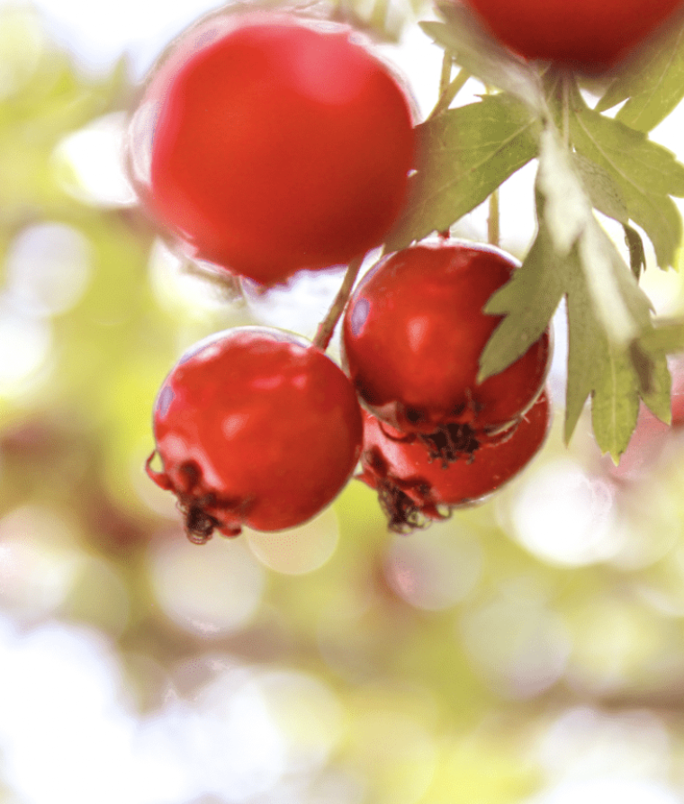
Cranberries
The goal of this was to focus on the berries and create a vibrant energy. To do this, I zoomed in and this made the background blurry.

Slide 4
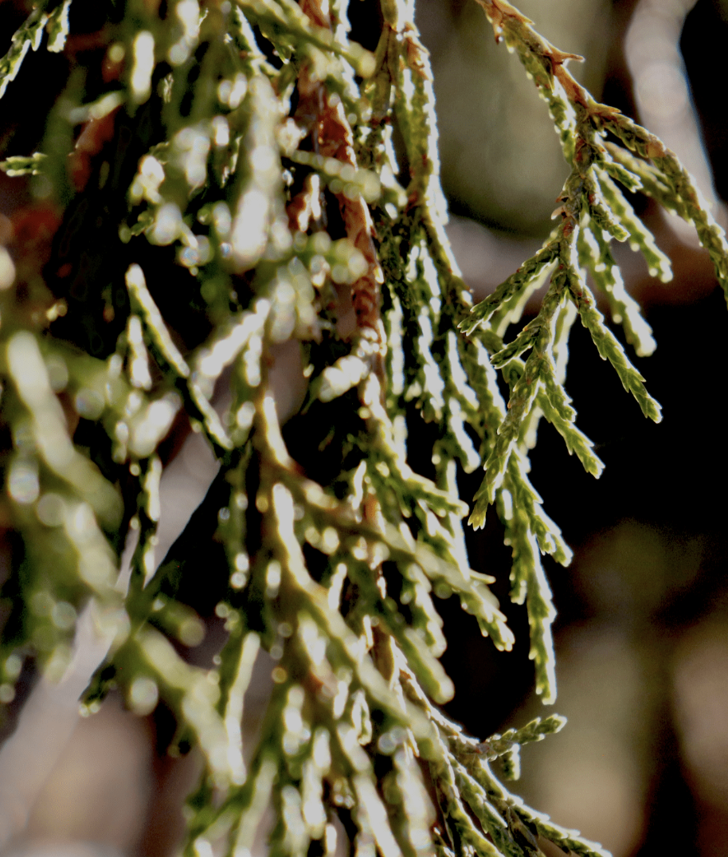
Pine Needles
The goal of this picture was to use the lighting to enhance the photo. I zoomed in on the needles making them stand out.

Slide 5
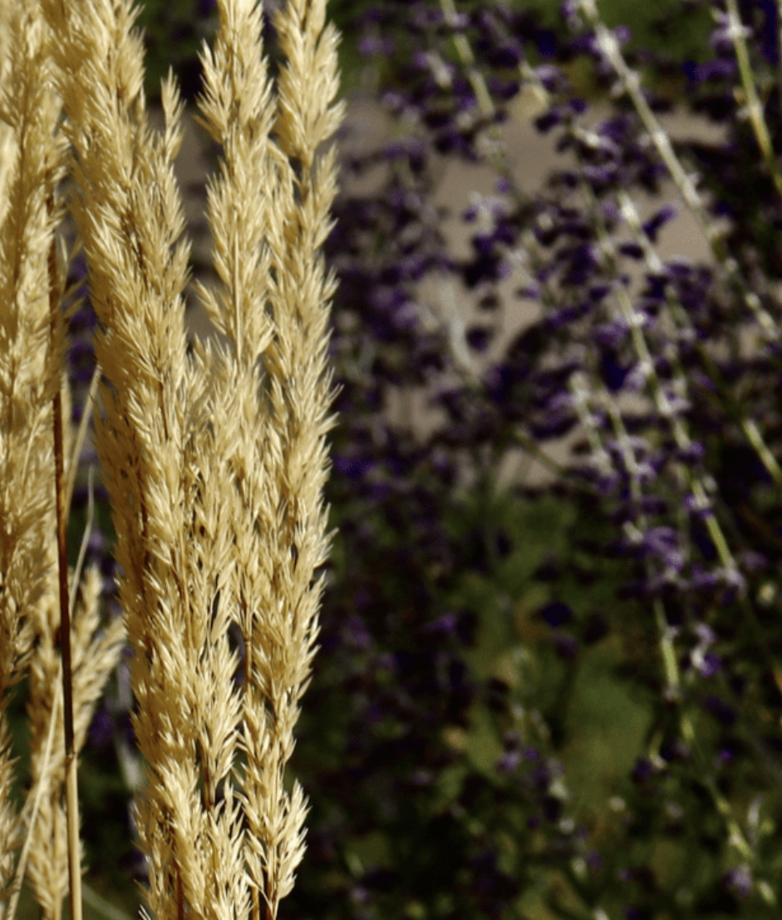
Wheat Grass
The goal for this picture was to capture the yellow but also have the contrast of the purple in the background. I focused on the grass so that the background could blend.

Slide 6
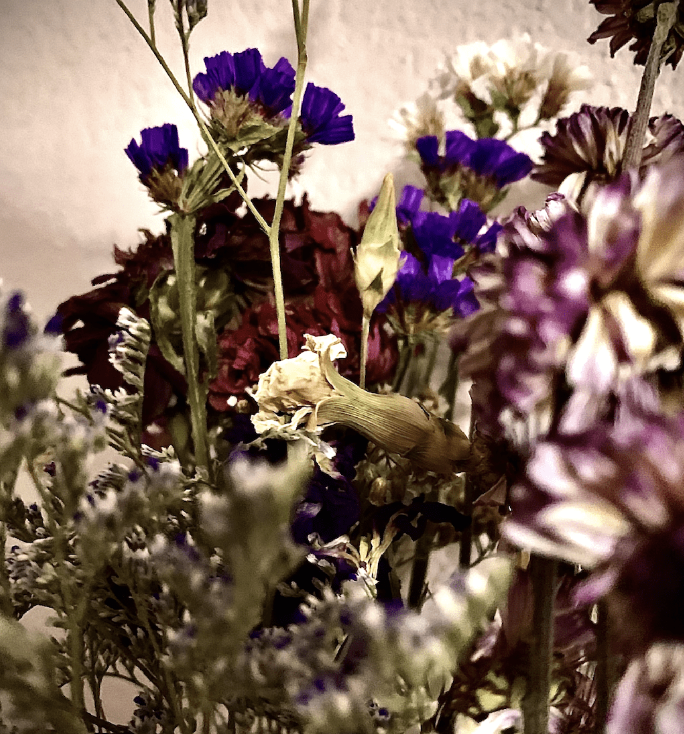
Vintage Flowers
The goal of this picture was to capture the older look and the beauty of these dry flowers. To do this, I edited it and gave it a vignette.

Slide 7
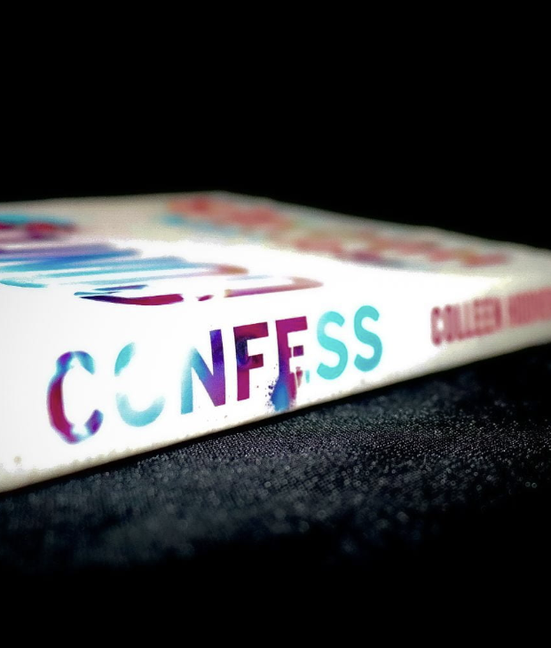
Confess
The goal of this picture was to use the lighting to make the colors really pop. In order to do this, I focused on the words so that it would be extra bright.

Slide 8
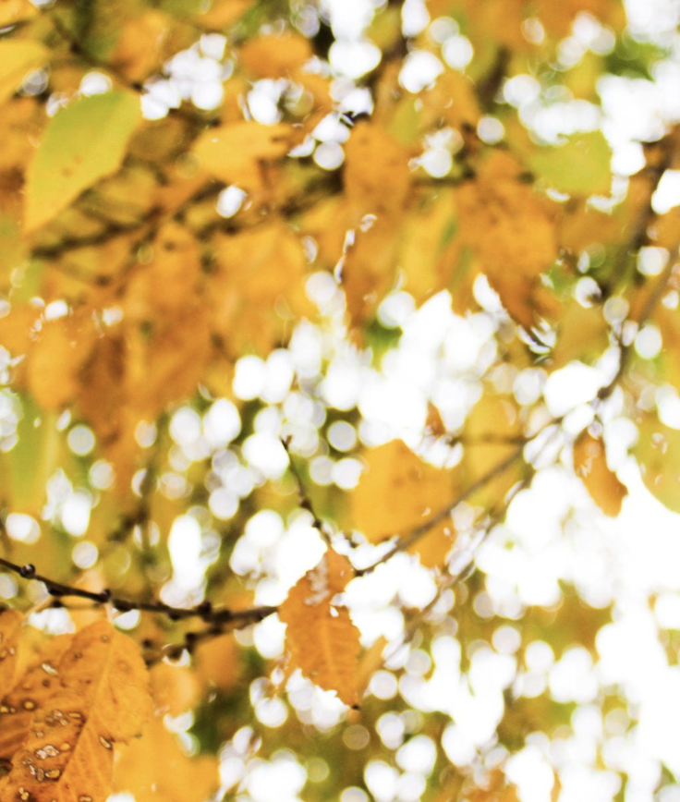
Fall Leaves
The goal of this picture was to create the fall energy and focus on something in one corner. To do this I zoomed in on that leaf so that the rest would stand out.

Slide 9
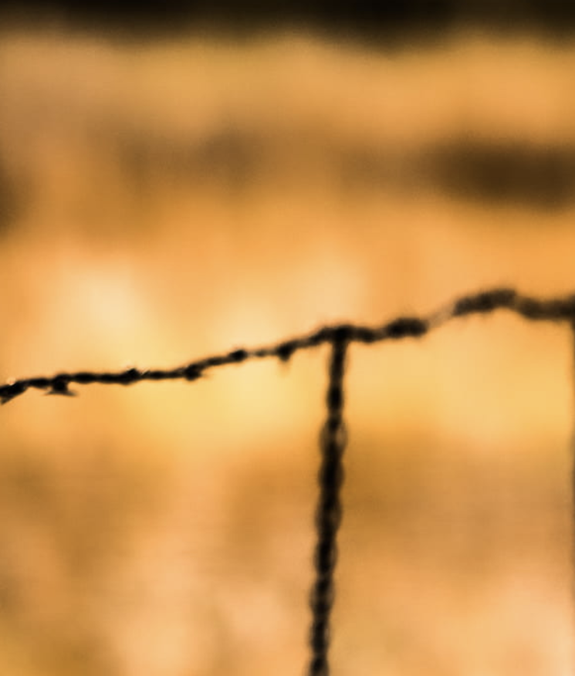
Barbed Wire
The goal of this picture was to capture the contrast between the fence and the grass behind it. In order to do this I blurred the entire picture.

Slide 10
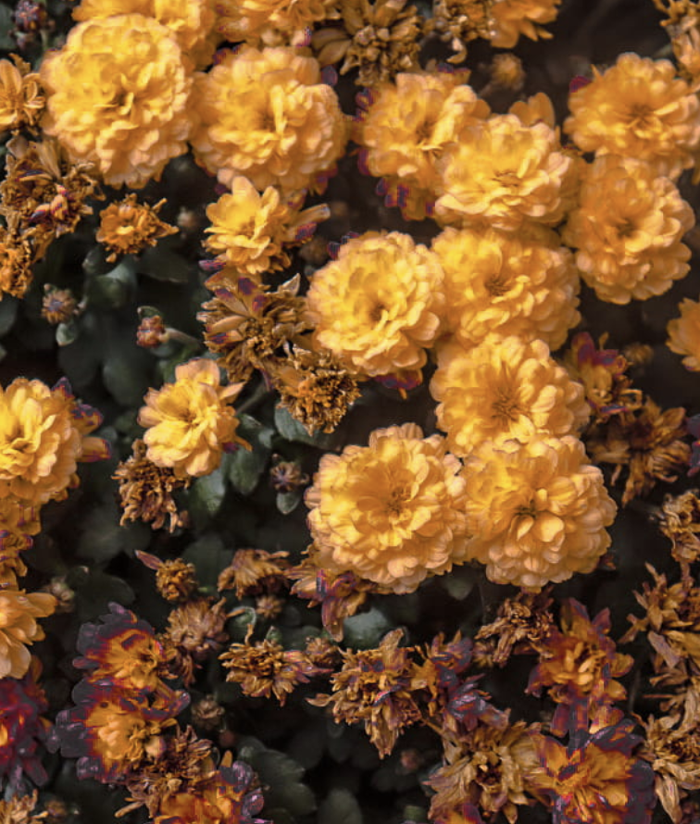
Flowers
The goal of this picture was to grasp the beauty of the little flowers. To do this I edited it to make it look more vintage

Slide 11
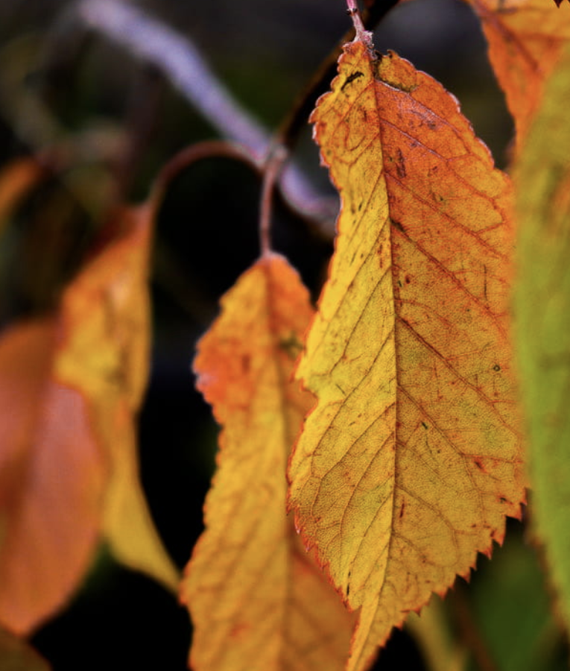
Dangling Leaves
The goal of this picture was to use the lighting from my side of the camera to make the leaves have a glowing affect.

Slide 12
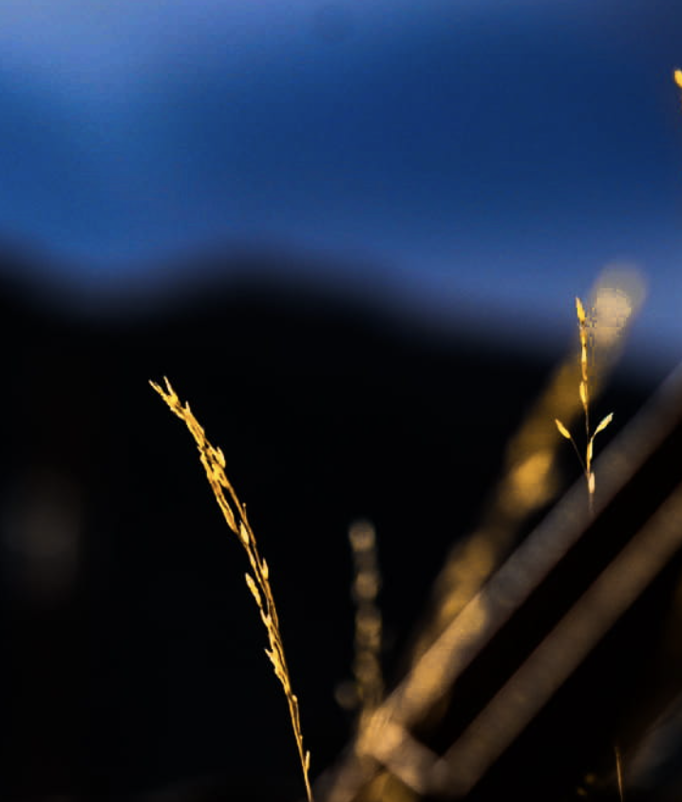
Golden Grass
The goal of this picture was to capture the golden vibrance from the grass, but keep the mountain in the background.

Slide 13
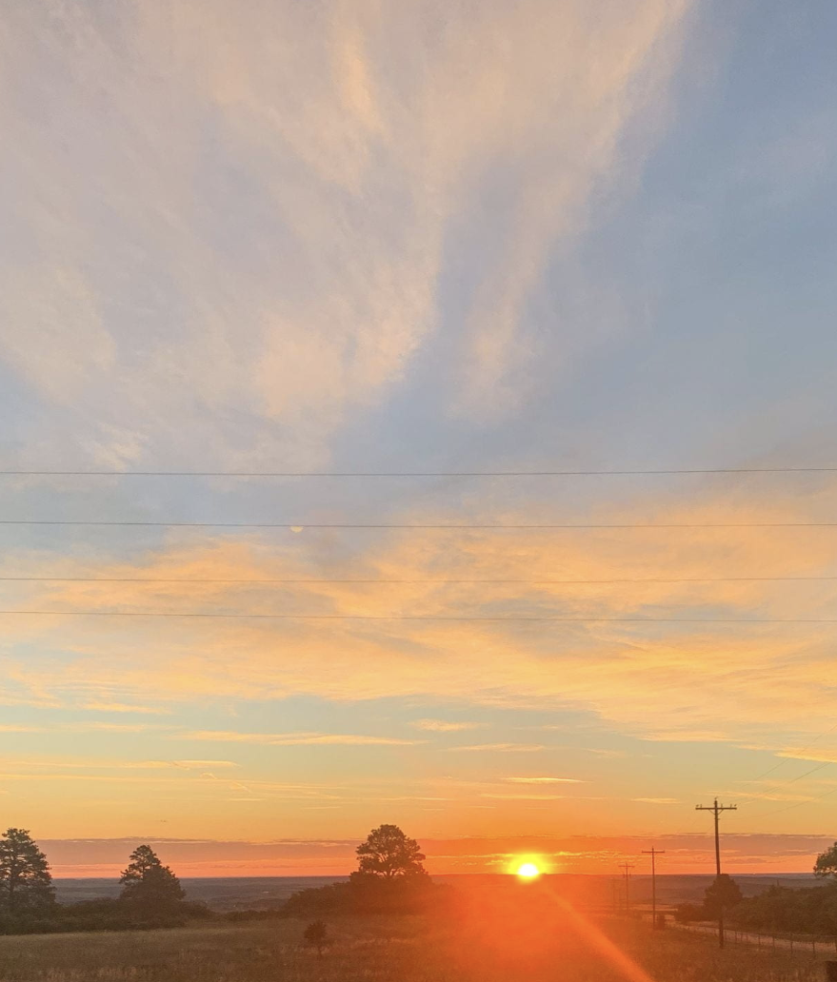
Sunrise
The goal of this picture was to capture the beauty of a new day.

Slide 14
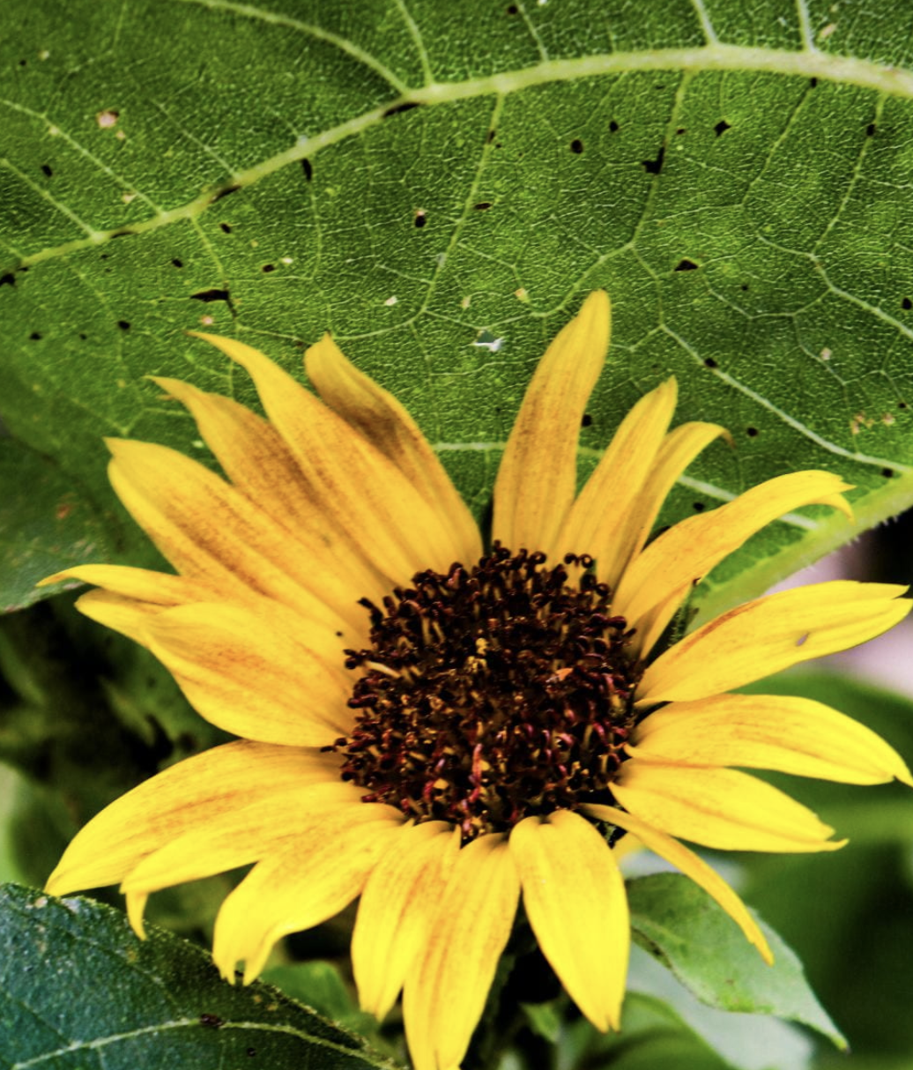
Sunflower
The goal of this picture was to capture the details of the sunflower.

Slide 15
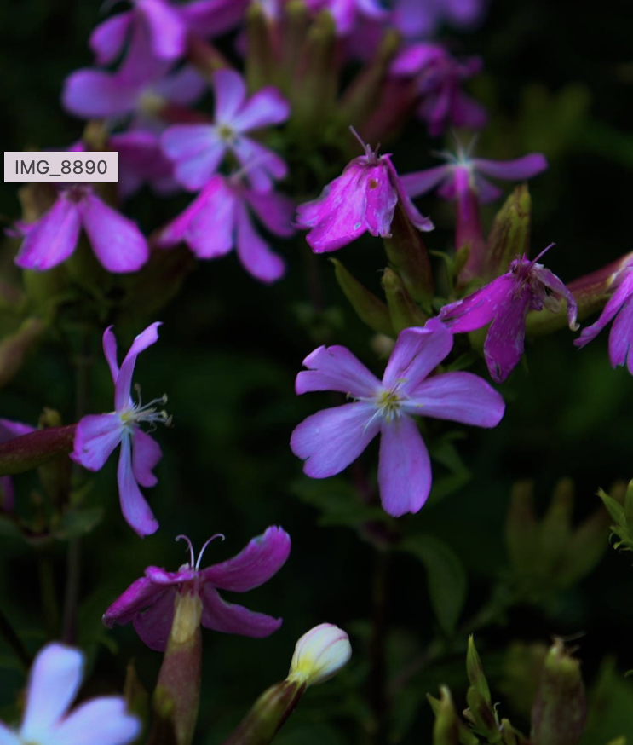
A Glimpse of Spring
The goal of this picture was to make the flowers stand out and be ultimately vibrant.

Slide 16
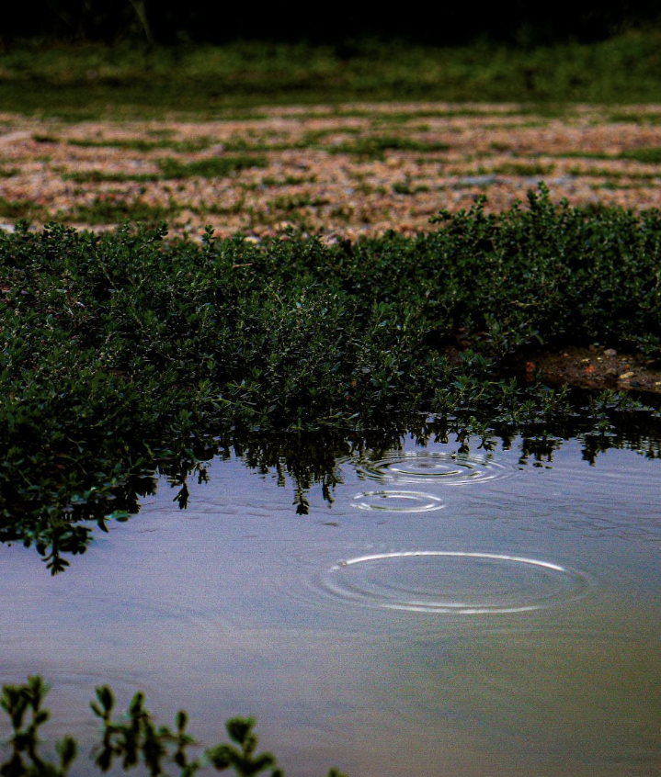
Puddle
The goal of this picture was to capture the patterns of the water and the contrast in the background.

Slide 17
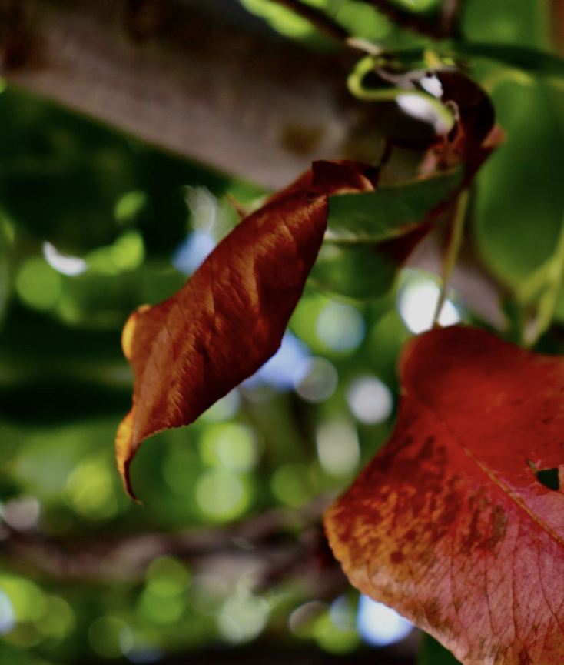
Red Leaves
The goal of this picture was to Capture the Contrast of the leaves from the background.

Slide 18
My Favorite Assignment
My favorite assignment was Up Close and Detail Landscape Photos. I liked this assignment because I got to See the absolute beauty in the pieces of nature around me.

Slide 19
My Progress in Photography
I would say that I have made great progress in this semester's photography class. When I look at my photos from the beginning of the semester until now, I see great progress.

